Slide 1

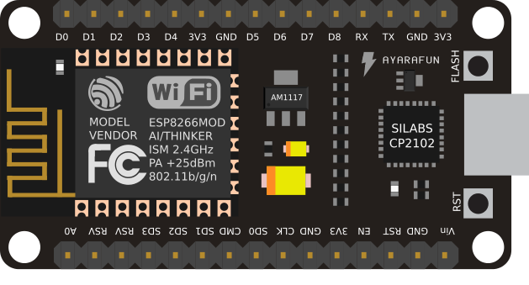

NODE MCU[ESP8266-12]
Raj Kumar Thavti

Slide 2


Introduction:
Node MCU is an open-source firmware and development kit that helps you to prototype your IOT product.
Arduino-like hardware IO
Lowest cost WI-FI
Contains ESP8266-12 from Espressif

Slide 3
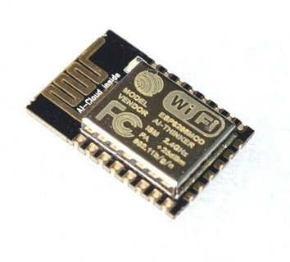
ESP8266 Module
The ESP8266 module is a IoT device consisting of a 32-bit ARM microprocessor with support of WIFI network and built-in flash memory.
This architecture allows it to be programmed independently, without the need of other microcontrollers like the Arduino, for example.

Slide 4
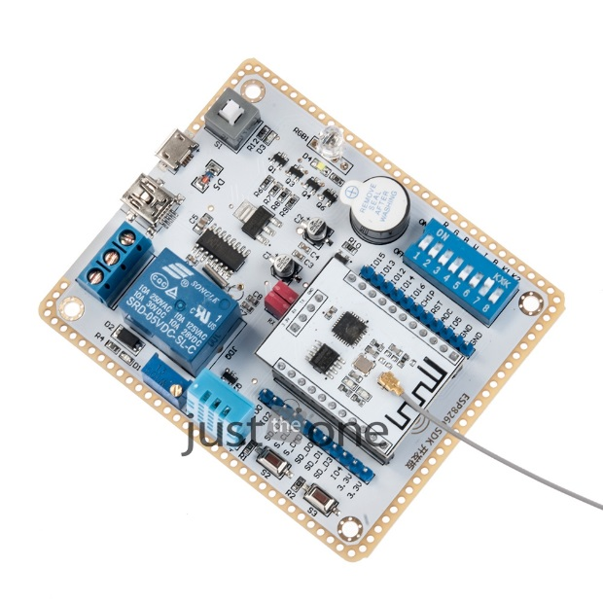
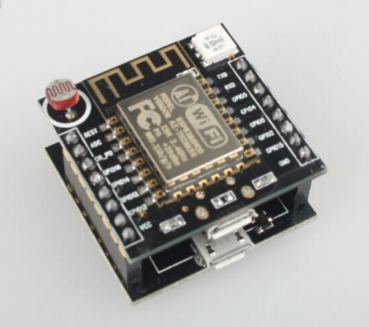
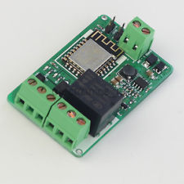
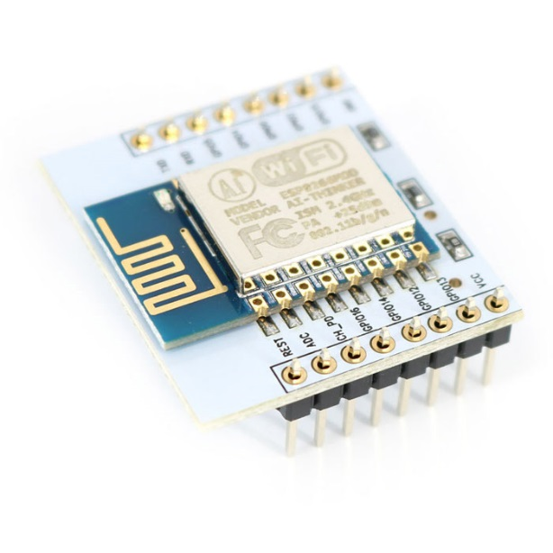
Variants:
NodeLHC
ESP201
Wemos D1
Adafruit HUZZAH ESP8266
NodeMCU

Slide 5
The NodeMCU Platform:
Controller board consisting of a ESP8266 module
Micro USB Port to power (5 volts) and programming
10 digital inputs GPIOs operating at 3.3V and an analog input GPIO to 1.8 V
Development kit based on the Lua language & Embedded C

Slide 6
Advantages of NodeMCU platform relative to the Arduino
Low cost
Integrated support for WIFI network
Reduced size of the board
Low energy consumption

Slide 7
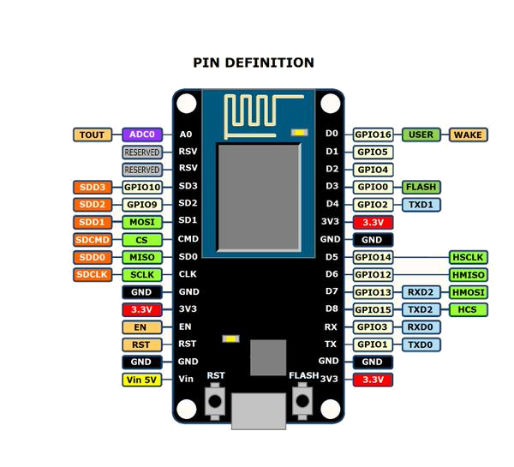
NodeMCU PINOUT:

Slide 8
Contd..
There are 6 extra GPIOs. All of them can be programmed as PWM, I2C, 1-wire, except for GPIO16 (D0).

Slide 9

Project with NodeMCU
Necessary Components
NodeMCU board
Led
220 ohms resistors (or approximated values)
Wire jumpers

Slide 10
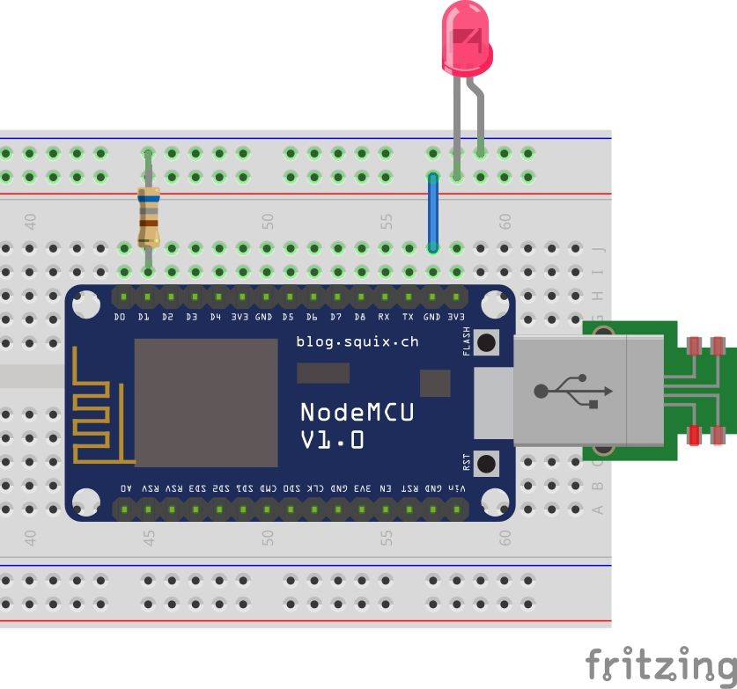
Connection diagram.

Slide 11
Program
The Sketch
*/
int LED = D1;
void setup() {
pinMode(LED, OUTPUT); }
void loop() {
digitalWrite(LED, HIGH); delay(500);
}

Slide 12
Libraries Integration to Arduino IDE.
Please refer the document from setup folder.

Slide 13
Practical……..

